Slide 1
Presentation On the topic: “Creating an application to optimize logistics operations”
Performed by: Mazhitov M.A.
Student. Ticket : 1032216461
Group: NKNbd-01-21
Teacher: Lobyntseva A.V.

Slide 2
Table of contents
1. Objective
2. Tasks
3. Research question and work plan
4. Hypothesis
5. The theoretical part
5.1 Studying the route selection algorithm
5.2 IoT analysis
5.3 Choosing the application architecture
6. The practical part
6.1 Choosing an algorithm and optimization methods
6.2 Application architecture
7. Conclusion

Slide 3
Objective
The aim of this research is to create an application that will allow logistics companies to increase the efficiency of their operations, reduce costs and improve the quality of service.

Slide 4
Tasks
Study algorithms for building routes and choose the best one
Study algorithms for building routes and choose the best one
Investigation of methods for optimizing vehicle filling
Application architecture development

Slide 5
Work plan
Research question
What technologies and methods can be used to create an application capable of optimizing logistics operations, including building efficient routes, inventory management and cargo monitoring, taking into account modern requirements for transparency, security and sustainability of logistics chains?
The theoretical part.
The practical part.
Conclusion and possible application.

Slide 6
Hypothesis
The use of modern information technologies, such as big data analysis, machine learning and blockchain, in the development of an application for optimizing logistics operations will significantly improve the efficiency and transparency of logistics processes

Slide 7
In the theoretical part, the main algorithms for building routes and methods of their optimization will be considered

Slide 8
The theoretical part
Algorithms for building routes: These are methods for finding the optimal route that takes into account various parameters such as distance, travel time, cost and the presence of obstacles on the route.

Slide 9
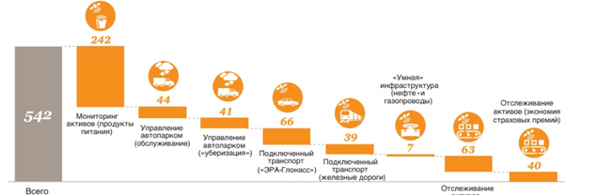
The theoretical part
The logistics sector is becoming a key area for the application of the Internet of Things (IoT). The development of intelligent transport technologies in cars is already reducing accidents, improving environmental performance and ride comfort. Data from street cameras, motion detectors and from transport users are used to control traffic flow.

Slide 10



The theoretical part
The choice of application architecture should take into account scalability, flexibility, security, performance, integration, ease of development and compliance

Slide 11
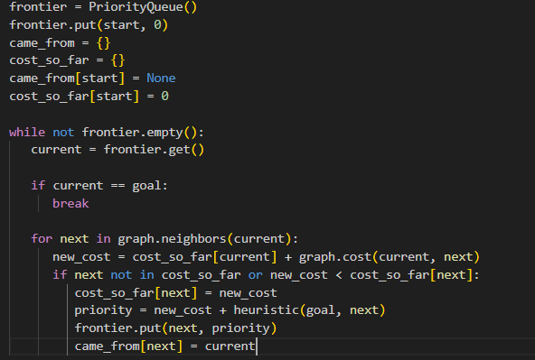
The practical part
Selecting and writing an algorithm for the desired task.
Choosing the algorithm optimization method

Slide 12
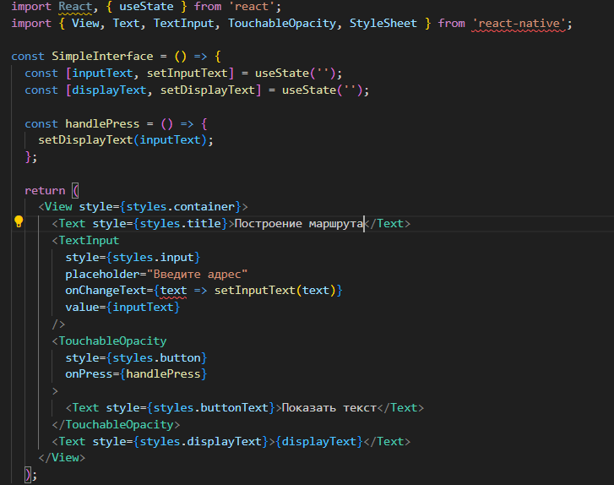
The practical part
Creating an application architecture based on budget, tasks to be implemented and future updates

Slide 13

Conclusion
The results of the study can be used to create an application for optimizing logistics operations.
Understanding the impact of various optimization methods of algorithms on the accuracy of route construction can help optimize the processes of automatic construction of optimized routes

Slide 14
List of literature
Кормен, Т., Лейзерсон, Ч., Ривест, Р., Штайн, К. "Введение в алгоритмы". М.: МЦНМО, 2005.
Арц, Э., Ленстра, Й. "Методы локального поиска в комбинаторной оптимизации". М.: Наука, 1987.
Голдберг, Д. "Генетические алгоритмы в поиске, оптимизации и машинном обучении". М.: Мир, 1990.
React Native: "https://reactnative.dev/"
Swift: "https://swift.org/"
Kotlin: "https://kotlinlang.org/"

Slide 15
Thanks for your attention!

